Slide 1



Department of Allied - Computer Science and Engineering
VIGNAN’S LARA INSTITUTE OF TECHNOLOGY AND SCIENCE
Project Review
on
Sentinel: A Self-Healing Email Threat-Detection System with
Privacy-Preserving Behavioral Profiling and Multi-Signal Attacker Attribution
Under The Esteemed Guidance of
G. Poojitha M-tech
Asst. Professor
ACSE Department
Presented By Batch No: 14 23FE1A4401
23FE1A4423
23FE1A4417
23FE5A4439
A. SAI
K. V. K. SATWIK
G. PRANAV NADH REDDY
P. SIVA SHANKAR
Department of Allied - Computer Science & Engineering
1

Slide 2
Abstract
Project Sentinel is a privacy-preserving email threat-detection system designed to detect phishing, spear-phishing, Business Email Compromise (BEC), and coordinated email attacks without reading or storing email body content. It analyzes only email metadata such as headers, routing information, IP addresses, and authentication results, and combines Digital Twin behavioral profiling, Bayesian attacker attribution, multi-agent AI, attack-graph correlation, and a self-healing policy engine to identify and respond to evolving threats.
2

Slide 3
Problem Statement & Industry Challenges
Privacy & Compliance Dilemma: Modern email security tools inspect plaintext email bodies, creating legal liabilities under GDPR, HIPAA, and CCPA. Unable to inspect end-to-end encrypted (E2EE) messages.
Sophisticated Attacker Evasion: Attackers easily mask origins using VPNs, Tor, residential proxies, and lookalike domains.Single-point indicator of compromise (IoC) lookups fail against fast-flux infrastructure.
Alert Fatigue & Manual Remediation: SOC analysts are overwhelmed with alerts; manual policy updating takes hours or days while active campaigns spread.

Slide 4
The Proposed Solution
Zero-Payload Threat Detection: Operates strictly on RFC 5322 header metadata and routing envelopes—never reads, stores, or inspects email body content.
Behavioral Digital Twins: Maintains privacy-preserving sender profiles to detect behavioral deviations.
Multi-Signal Bayesian Attribution: Fuses 8+ metadata signals to unmask VPN-backed threat actors.
Multi-Agent AI Orchestration: 4 cooperative AI agents perform forensic analysis, risk scoring, end-user explanation, and red-team evasion simulation.
Autonomous Self-Healing: Closes the loop by auto-updating firewall and anomaly policies in real-time.

Slide 5
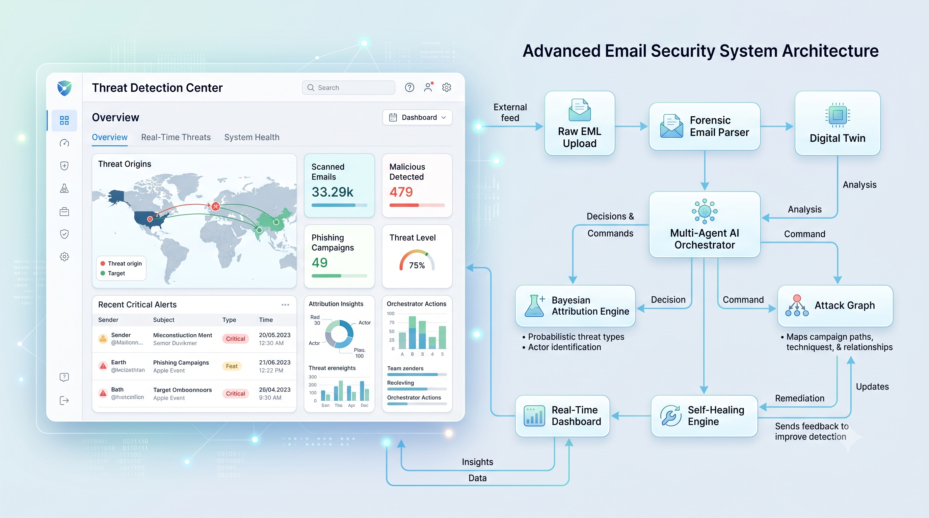
System Architecture & 6-Phase Pipeline

Slide 6
Literature Survey
S.No | Paper Title | Methodology | Drawbacks | Proposed Methodology to Overcome Drawbacks
1 | Blocking Phishing e-mail by extracting header information of e-mails | Detects phishing emails by extracting and analyzing information from email headers. | Authentication protocols are not universally deployed and failed authentication does not always prevent spoofed emails from reaching users. | Extend header-only analysis with Digital Twin behavioral profiling, Bayesian attribution, and attack-graph correlation.
2 | Forensic analysis of E-mail address spoofing | Detects phishing emails by extracting and analyzing information from email headers. | Primarily focuses on sender spoofing and authentication; does not provide broader behavioral or coordinated-attack detection. | Combine authentication results with behavioral anomaly detection, multi-agent risk scoring, and campaign correlation. (IEEE Xplore)

Slide 7
Literature Survey
S.No | Paper Title | Methodology | Drawbacks | Proposed Methodology to Overcome Drawbacks
3 | Spear Phishing Emails Detection Based on Machine Learning | Uses stylometric, forwarding-relationship and reputation features with ML classifiers to detect spear-phishing. | Requires multiple feature sources and focuses on classification of individual spear-phishing emails. | Use privacy-preserving metadata features + Digital Twin + graph-based campaign detection to identify coordinated attacks. (IEEE Xplore)
4 | Phishy? Detecting Phishing Emails Using ML and NLP | Compares six ML algorithms using NLP-based features to classify phishing emails. | Depends on email-content/NLP features and does not address privacy-preserving metadata-only detection. | Avoid reading message content and instead use email headers, behavioral metadata and authentication signals. (IEEE Xplore)

Slide 8
Literature Survey
S.No | Paper Title | Methodology | Drawbacks | Proposed Methodology to Overcome Drawbacks
5 | Segmental parameterisation and statistical modelling of e-mail headers for spam detection | Performs spam filtering using only email-header information, motivated partly by privacy concerns. | Focuses on statistical header-based spam filtering rather than phishing/BEC, behavioral profiling or coordinated campaigns. | Extend header-only detection with Digital Twins, Bayesian attribution and multi-agent threat analysis. (ScienceDirect)
6 | A multi-tier phishing detection and filtering approach | Uses weighted features from message content and headers with a multi-tier classification model. | Uses message content, so it does not provide a strictly privacy-preserving metadata-only architecture. | Restrict analysis to metadata and add behavioral anomaly detection and self-healing policies. (ScienceDirect)

Slide 9
Phase 1 & 2 — Forensic Parser & Digital Twins
Phase 1 — Forensic Parser (email_parser.py):
  Extracts 30+ metadata fields: hop-by-hop Received: chains, SPF/DKIM/DMARC authentication results, ARC chains, X-Originating-IP, client User-Agents, and MIME encoding structures.
  Hard privacy constraint: MIME body parts (text/plain, text/html) are explicitly dropped.
Phase 2 — Behavioral Digital Twin (digital_twin_builder.py):
  Profiles 7 behavioral dimensions: Sending Hours (UTC), Weekday distribution, IP /24 subnet prefixes, Send frequency, Contact network (SHA-256 hashed), Domain patterns, and Charset transitions.
  Weighted Anomaly Fusion: {Anomaly} = 0.20({Hour}) + 0.15({Day}) + 0.25({IP}) + 0.15({Freq}) + 0.10({Domain}) + 0.10({Charset}) + 0.05({Subject})
  Anomaly > 0.50 Elevated scrutiny; Anomaly $> 0.70 Self-healing trigger.

Slide 10
Phase 3 — Bayesian Attacker Attribution
Defeating VPN & Proxy Evasion: A single IP geolocation is easily bypassed with VPNs. Sentinel fuses 8 independent forensic signals.
Signals Combined:
  X-Originating-IP & Relay hop IPs
  UTC Timezone offset in Date: header
  MIME Charset encoding distributions
  Domain registrar TLD & ASNs
  Inter-hop routing latency & Geographic timing
Bayesian Posterior Formulation: P({Country}/{Signals}) = P({Signals}/{Country}) * P({Country})
Result: To evade attribution, an attacker must falsify all 8 layers simultaneously rather than simply switching their proxy IP.

Slide 11
Phase 4 — Multi-Agent AI Orchestration
Sequential 4-Agent Architecture (powered by CrewAI / GPT-4 + deterministic fallbacks):
  Detection Agent (Forensic Analyst): Evaluates SPF/DKIM/DMARC, display-name spoofing, Levenshtein lookalike domains, header injection, and suspicious relay hop counts (Score 0–100).
  Risk Scoring Agent (Decision Engine): Fuses forensic score with Digital Twin anomaly score: {Risk Score} = 0.6 *{Detection} + 0.4 * ({Anomaly} * 100) 0–35: ALLOW | 35–50: REVIEW | 50–75: ALERT | 75–100: QUARANTINE
  Explanation Agent (Communicator): Generates transparent, plain-English explanations for end users and non-technical staff.
  Adversarial Agent (Red-Team Challenger): Simulates bypass strategies against the current detection and feeds evasion intelligence directly to the Self-Healing engine.

Slide 12
Phase 5 & 6 — Attack Graphs & Self-Healing Defense
Phase 5 — Attack Graph Correlator (attack_graph.py):
  Built on NetworkX: Models entities (email, ip, domain, subnet, msgid_domain) as a directed graph.
  Discovers coordinated phishing waves across distributed senders via Degree and Betweenness Centrality.
  Identifies campaigns when 3$ emails share infrastructure hubs.
Phase 6 — Autonomous Self-Healing (self_healing.py):
  Eliminates human response delays through autonomous policy adaptation:
  Risk 75$ (Quarantine): Auto-appends malicious IP & domain to firewall blocklists.
  Adversarial feedback: Dynamically tightens anomaly thresholds and expands suspicious hour matrices.
  Maintains a full, tamper-evident audit log for SOC governance.

Slide 13
Technology Stack & Implementation
Layer | Technology | Purpose & Rationale
Backend API | FastAPI (Python) | High-performance asynchronous routing, OpenAPI docs
Agent Orchestration | CrewAI / GPT-4 | Multi-agent reasoning with deterministic rule fallback
Graph Analytics | NetworkX | Real-time centrality and campaign clustering algorithms
Mathematical Engine | NumPy | Vectorized Bayesian probability & anomaly z-score math
Frontend Dashboard | Next.js 14 & Tailwind CSS | Server-side rendering, responsive dark-mode cyber UI
Visualizations | D3.js & Recharts | Dynamic force-directed attack graphs and threat charts
Live Streaming | WebSockets | Sub-second telemetry push from backend to UI
Deployment | Docker Compose | Containerized full-stack deployment

Slide 14
Experimental Results & Dataset Benchmark
Metric | Measured Value
Total Ingested Emails | 7,446 emails
Successfully Processed | 6,741 emails (90.53%)
Processing Throughput | 16.1 emails / second (461s total runtime)
Average Decision Latency | 1,238 ms per email
Coordinated Campaigns Detected | 4,644 campaigns
Decision Breakdown | 98.7% REVIEW, 1.2% ALLOW, 0.1% ALERT
Key Takeaways:
  Accurately categorized 98.7% of suspicious samples for human-in-the-loop review.
  Successfully grouped disparate emails into 4,644 correlated campaigns through shared relay nodes and domains.

Slide 15
Privacy & Security Architecture
Strict Privacy by Design:
  No email body, attachment payload, or message text is ever parsed, decrypted, or stored.
  Compatible with transparent MTA-level proxies and end-to-end encrypted email systems.
Data Minimization & Anonymization:
  Recipient and contact networks stored solely as SHA-256 one-way hashes.
  IP addresses coarsened to /24 CIDR blocks to prevent user location tracking.
Enterprise Ready: Full compliance alignment with GDPR (Article 5 & 25), HIPAA, and CCPA.

Slide 16
Limitations & Future Roadmap
Current Limitations:
  Cold-Start Window: Digital Twins require ~20 baseline emails to reach optimal confidence.
  Parser Edge Cases: 9.47% malformed RFC-noncompliant headers produced parse errors.
Future Roadmap:
  Adaptive MIME Parser: Self-recovering fallback parsers for corrupted headers.
  Federated Digital Twins: Cross-organization threat intelligence sharing with differential privacy.
  Explainable AI (XAI): SHAP-value feature attribution overlays for SOC analysts.
  Native Client Integrations: Direct plugins for Microsoft 365, Google Workspace, and Thunderbird.

Slide 17
Conclusion & Key Highlights
Key Takeaways:
  High-Accuracy Without Spying: Proved email headers provide ample telemetry for threat classification without touching message bodies.
  Intelligent Attribution: Bayesian multi-signal fusion overcomes VPN and proxy obfuscation.
  Autonomous Resilience: Multi-agent reasoning coupled with self-healing rules shrinks incident response time from days to milliseconds.

Slide 18
Q&A
Questions & Discussion
Thank you!

